Slide 1


INSTAGRAM USER ANALYTICS
SQL Fundamentals
Submitted by : Sruthi Suresh

Slide 2


CONTENTS
PROJECT DESCRIPTION
APPROACH
TECH-STACK USED
MARKETING ANALYSIS – INSIGHTS
LOYAL USER REWARD
INACTIVE USER ENGAGEMENT
CONTEST WINNER DECLARATION
HASHTAG RESEARCH
AD CAMPAIGN LAUNCH
INVESTOR METRICS – INSIGHTS
USER ENGAGEMENT
BOTS & FAKE ACCOUNTS
CONCLUSION

Slide 3
PROJECT DESCRIPTION: Analyzing Instagram User Interactions and Engagement
This project intends to conduct an extensive analysis of the user engagement process with one of the world's most popular social media platforms : Instagram.
As a data analyst working with the product team at Instagram, this project involves analyzing user interactions and engagement with the Instagram app to provide valuable insights that can help the business grow.
User analysis involves tracking how users engage with a digital product, such as a software application or a mobile app. The insights derived from this analysis can be used by various teams within the business. For example, the marketing team might use these insights to launch a new campaign, the product team might use them to decide on new features to build, and the development team might use them to improve the overall user experience.

Slide 4
APPROACH
Created database :
Inserted the values in the database created, using the commands & SQL queries as given in the Dataset file in the MySQL database using MySQL workbench.
Understand the structure of the provided tables : Users, Photos, Comments, Likes, Follows, Phototags and Tags.
Examining the datatypes and possible relationships between the tables.
SQL queries are used to manipulate and perform the analysis : Marketing analysis & Investor metrics which will help in extracting meaningful insights from the data.

Slide 5

TECH – STACK USED
MySQL Workbench 8.0 CE
The SQL File link:

Slide 6
MARKETING ANALYSIS
Loyal User Reward
To identify the five oldest users on Instagram as the marketing team wants to reward the most loyal users, i.e., those who have been using the platform for the longest time.
Inactive User Engagement
To identify users who have never posted a single photo on Instagram as the team wants to encourage inactive users to start posting by sending them promotional emails.
Contest Winner Declaration
To determine the winner of the contest and provide their details to the team as the team have organized a contest where the user with the most likes on a single photo wins.
Hashtag Research
To identify the top five most commonly used hashtags on the platform as a partner brand wants to know the most popular hashtags to use in their posts to reach the most people.
Ad Campaign Launch
To determine the day of the week when most users register on Instagram as the team wants to know the best day of the week to launch ads.

Slide 7
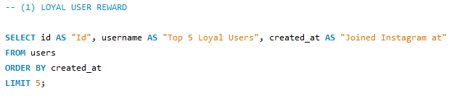
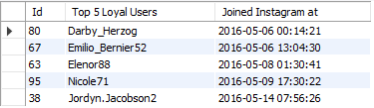
1. Loyal User Reward
The top 5 Loyal Users i.e., the oldest users who will get the rewards are as follows:

Slide 8
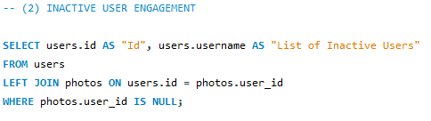
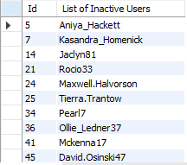
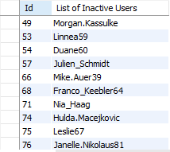
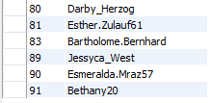
2. Inactive User Engagement
There are 26 users who have never posted a single photo on Instagram. The following people with their respective Id will be receiving promotional emails to post their 1^{rst} photo:

Slide 9
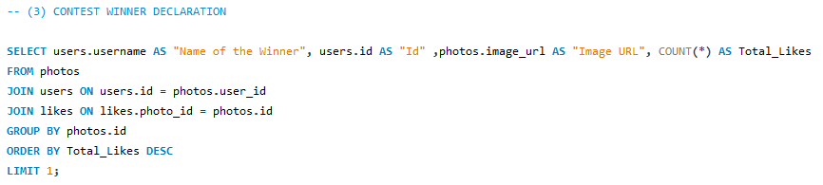

3. Contest Winner Declaration
The winner of the contest who is having most likes for a single photo is :

Slide 10
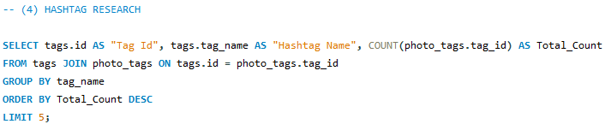
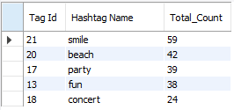
4. Hashtag Research
The top five most commonly used hashtags on the platform are as follows:

Slide 11
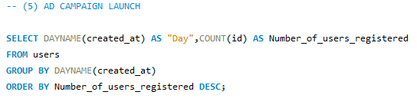
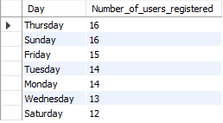
5. Ad Campaign Launch
The best day of the week to launch ads will be Thursday & Sunday as inferred from the result:

Slide 12
INVESTOR METRICS
To calculate the average number of posts per user on Instagram. Also, provide the total number of photos on Instagram divided by the total number of users as the Investors want to know if users are still active and posting on Instagram or if they are making fewer posts.
User Engagement
To identify users (potential bots) who have liked every single photo on the site, as this is not typically possible for a normal user as the Investors want to know if the platform is crowded with fake and dummy accounts .
Bots & Fake Accounts

Slide 13




1. User Engagement

Slide 14



1. User Engagement

Slide 15
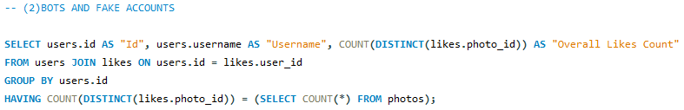
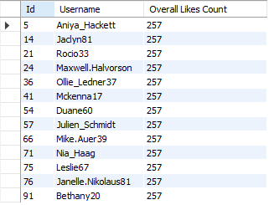
2. Bots & Fake Accounts
There are 13 users (potential bots) who have liked every single photo on the site, as this is not typically possible for a normal user which account for 13% of the total users and they are as follows:

Slide 16
CONCLUSION
The insights drawn from Instagram User Analytics project focusing on the Marketing and Investor Metrics have helped in understanding and extracting valuable information such as the most loyal users, top 5 most used hashtags, the best day of the week to launch ads and to identify the bots and fake accounts etc., could possibly help in the potential development and progress of one of the most popular social media platform Instagram.
This analysis could help in making data-driven decisions, whether the platform is growing or became stagnant in its growth etc., by extracting meaningful insights from the data using SQL and MySQL Workbench tool.

Slide 17
THANK YOU

